Slide 1
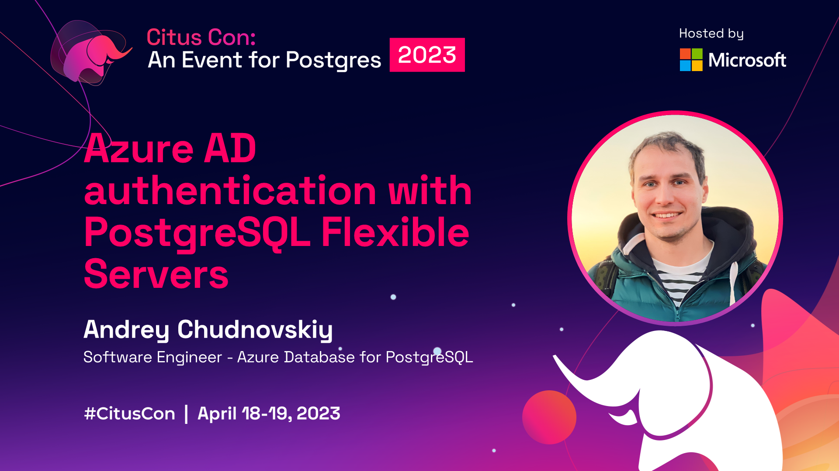

Slide 2







About Me

Slide 3
Azure Active Directory
Cloud-based identity and access management (IAM)
Implements industry standards for authentication: OAUTH2, OpenId Connect (OIDC)
Multiple authentication factor options
Advanced enterprise security and management features.
Microsoft Graph – Users, Groups, Applications and Identities metadata API

Slide 4
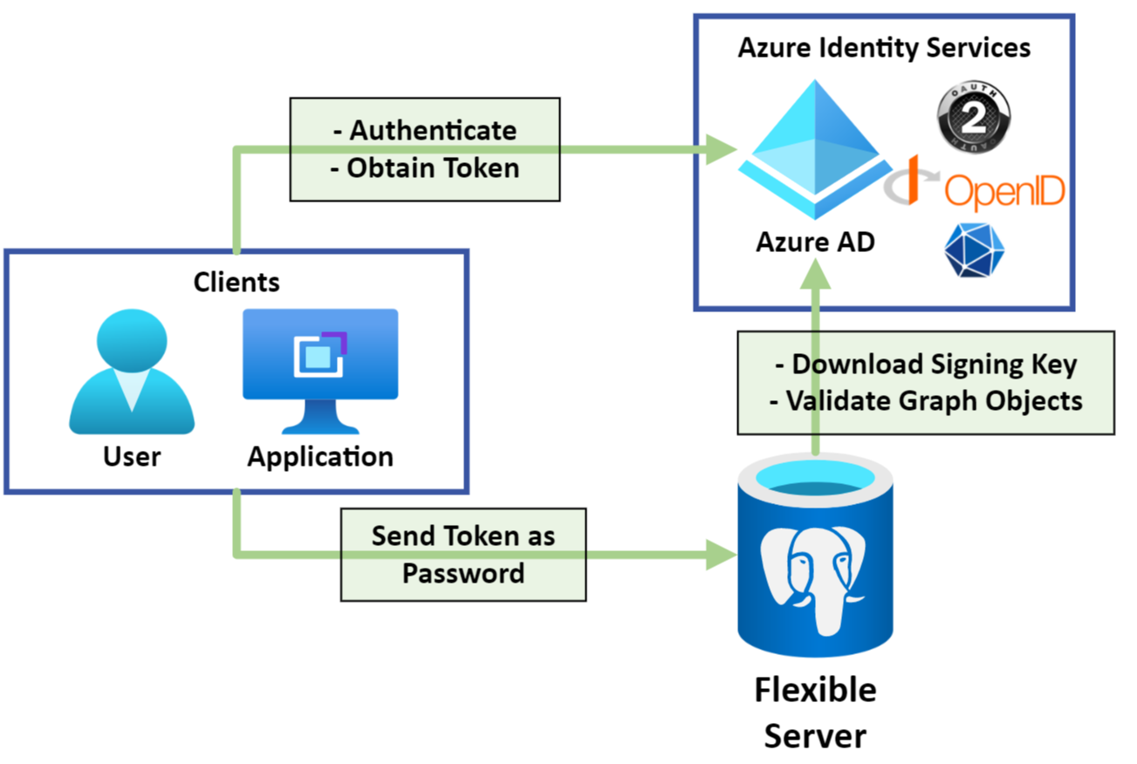
Azure AD Authentication in Flexible Servers
Authentication exchange between Client and AAD
Token as Password
PostgreSQL validates token

Slide 5
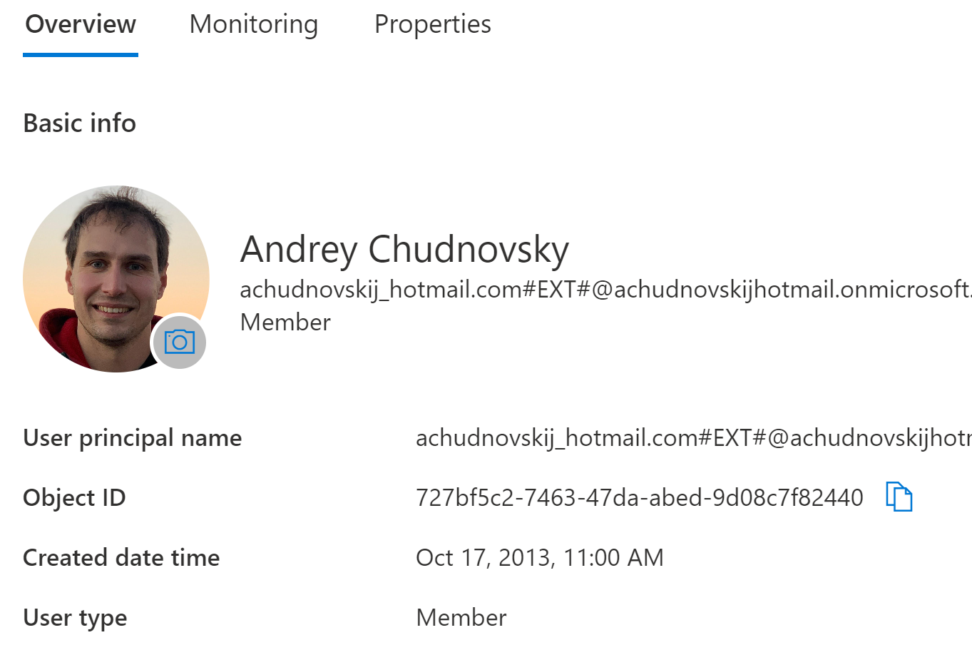
Azure AD is integrated throughout Azure
Every Azure user is Azure AD user.
Find your Tenant with Sign In status
Azure AD can be managed in Portal
Azure AD authentication works with free Azure AD tier and on the minimal PostgreSQL Flexible SKUs

Slide 6
Quick Start -Setup
1. Create Server | az postgres flexible-server create --name "expenses-db" --resource-group "expenses-app" --active-directory-auth "Enabled“
2. Create Admin (via CLI) | az postgres flexible-server ad-admin create --resource-group "expenses-app" --server-name "expenses-db" --display-name "admin@expenses.app" --object-id "<object_id>" --type "User“

Slide 7
Quick Start - Connect
3. Get Token | export PGPASSWORD=$(az account get-access-token --resource-type oss-rdbms | jq -r .accessToken)
4. Connect | psql "host=server-name.postgres.database.azure.com port=5432 dbname=postgres user=admin@expenses.app“

Slide 8
Look Inside Azure AD Role in PG
select * from pgaadauth_list_principals(false);
rolname | admin@expenses.app
principaltype | user
objectid | f1d3f32b-8845-4b8d-94df-ff4e7a96ef05
tenantid | <Tenant_id>
ismfa | 0 // Is Multi factor enforced for role
isadmin | 1 // See Azure Ad Admin below
select * from pg_shseclabel; // You can look inside here to see how we store mapping
Azure AD Admin has privileges of regular Azure PG Admin role and can create other Azure AD enabled roles.

Slide 9
Security Principal Types
“user” - Users
“service” - Service Principals
Applications – "Clients" in OAUTH2. Can access with their own credentials or on user behalf
Managed Identities – Service Principal managed by Azure
“group” - Groups – Can contains users or service principals
*Object Id – Guid of User, Group or Service Principal. Use “Enterprise Applications” page in Azure Portal to find Service Principal Object Id
Note: Azure AD Authentication in PostgreSQL: 1 PG Role => 1 AAD Principal.

Slide 10
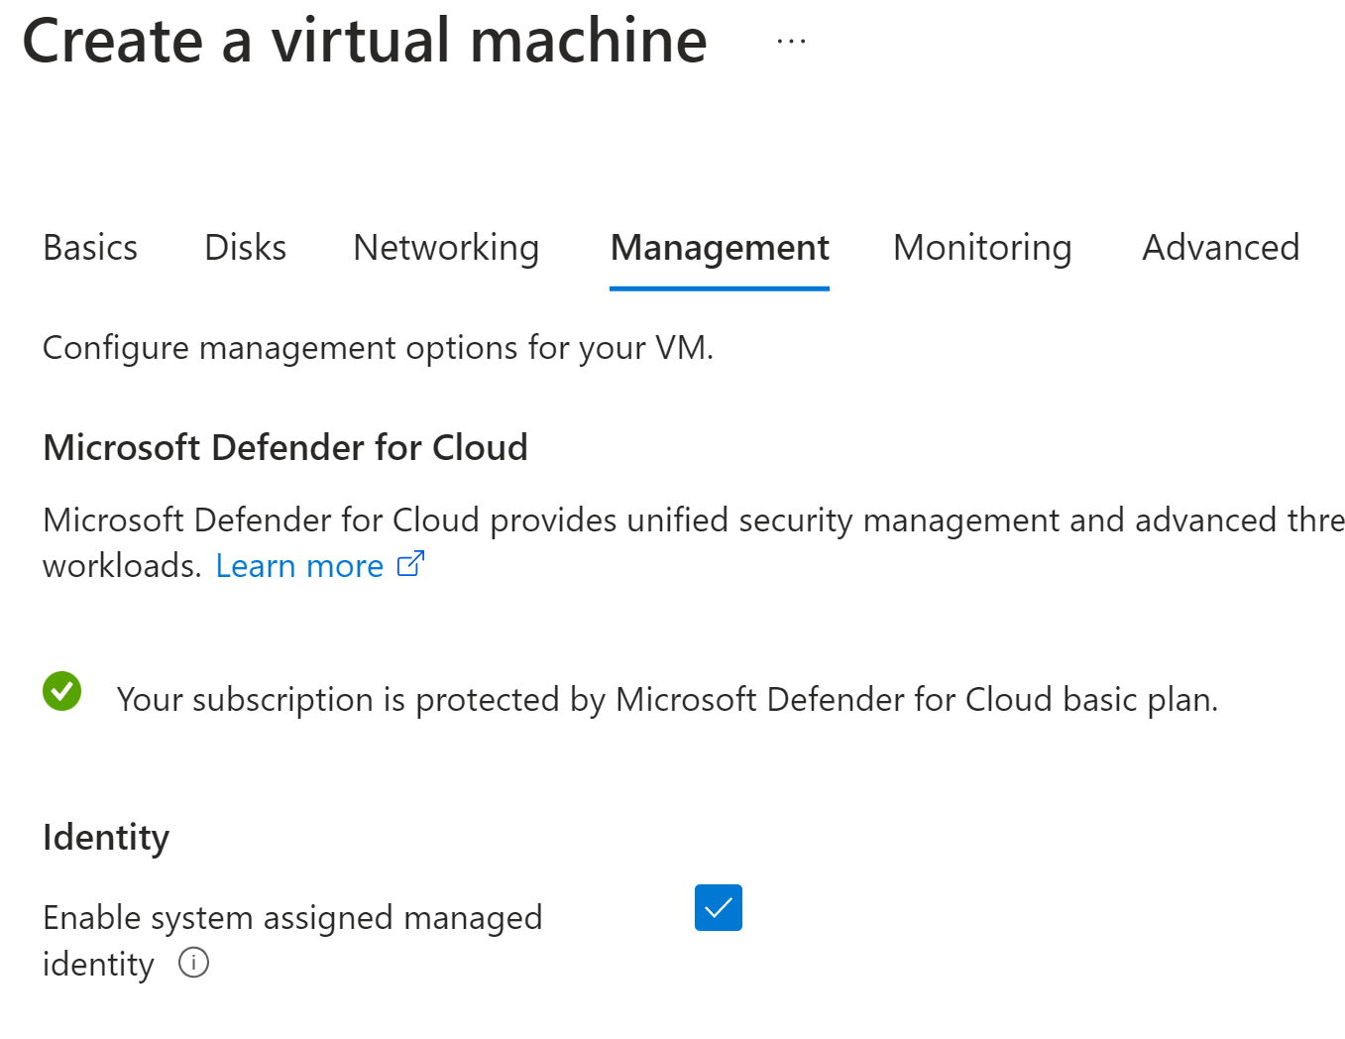
Setup a Managed Identity
Just connection from a VM as application would do using Managed Identity
Create an Azure VM with Managed Identity enabled
Install psql and jq
I’m using name “expenses-vm”
From your admin psql :
select * from pgaadauth_create_principal ('expenses-vm', false, false);
select * from pgaadauth_list_principals(false);

Slide 11
Connect as a Managed Identity
1. Allow VM connection | az postgres flexible-server firewall-rule create --resource-group "expenses-app" --name "expenses-db" --rule-name "allow-app" --start-ip-address "<vm_ip>" --end-ip-address "<vm_ip>"
2. Export managed Identity Url | export url=“http://169.254.169.254/metadata/identity/oauth2/token? api-version=2018-02-01&resource=https://ossrdbms-aad.database.windows.net/”

Slide 12
Connect as a Managed Identity
3. Get Token | export PGPASSWORD=$(curl -H "Metadata: true" “$(url)" | jq -r '.access_token’)
4. Connect | psql "host=expenses-db.postgres.database.azure.com port=5432 dbname=postgres user=expenses-vm"

Slide 13
Repeat with your App Platform
Java – Spring Cloud Azure supports seamless Managed Identity integration with Passwordless Connections
Use Azure SDKs to get Managed Identity Token:
Applications can authenticate with client secrets or certificates using MSAL libraries.
See https://azure.com/sdk for more info
.Net / .Net core | Node.js | Python
Go | Ruby

Slide 14
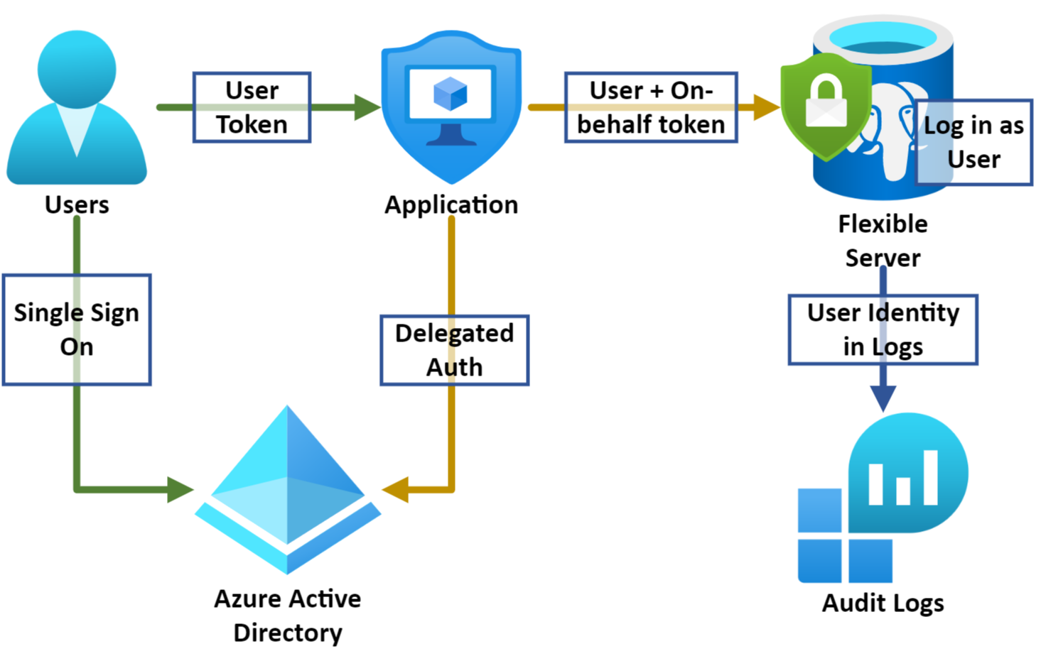
Impersonation / Delegated Auth
Application data access controlled by PG
Row level access to different slices of application data
Audit of Data operations in database

Slide 15
Login as a Group Member
1. Create group role (as admin) | select pgaadauth_create_principal("app-users", false, false);
2. Get user token (as app user) | export PGPASSWORD=$(az account get-access-token --resource-type oss-rdbms | jq -r .accessToken)
3. Connect as group role | psql "host=expenses-db.postgres.database.azure.com port=5432 dbname=postgres user=app-users"
* Must be security group

Slide 16
Login as a Group Member
1. Create group role (as admin) | select pgaadauth_create_principal("app-users*", false, false);
2. Get user token (as app user) | export PGPASSWORD=$(az account get-access-token --resource-type oss-rdbms | jq -r .accessToken)
3. Connect as group role | psql "host=expenses-db.postgres.database.azure.com port=5432 dbname=postgres user=app-users"
+ Simplifies Role Management
+ New users get access automatically
* Must be security group

Slide 17
Login as a Group Member
1. Create group role (as admin) | select pgaadauth_create_principal("app-users", false, false);
2. Get user token (as app user) | export PGPASSWORD=$(az account get-access-token --resource-type oss-rdbms | jq -r .accessToken)
3. Connect as group role | psql "host=expenses-db.postgres.database.azure.com port=5432 dbname=postgres user=app-users"
+ Simplifies Role Management
+ New users get access automatically
- Complicates Audit
- Re-login for Different Permissions
* Must be security group

Slide 18
Advanced Role Management
Create role | pgaadauth_create_principal_with_oid ('app-users', 'e2942019-441e-4cd9-8928-6cfebbaded5a', 'group', true, false);
Update role | pgaadauth_update_principal_with_oid ('app-users', 'e2942019-441e-4cd9-8928-6cfebbaded5a', 'group', true, false);
Parameters | Role Name Object Id Object Type Is Admin Is Mfa (only accept tokens with mfa claim)
Disambiguate non-unique names
Create readable role names
Re-map existing role to a new AAD principal

Slide 19
Final Points
Throughput / Performance
No slowdown for users / services
First time delay for user/group combo
PgBouncer
Supported with Build-in PgBouncer
VNet Deployments
Connection to Azure AD services must be open
Cross Tenant
Objects must be in the Server subscription tenant

Slide 20
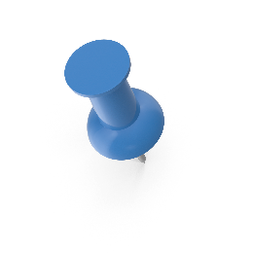



Thank you!
Link to my slides @ aka.ms/XXX
More Citus Con talks @ aka.ms/cituscon
linkedin.com/in/achudnovskij/
Microsoft Learn documentation @ aka.ms/docs-azuredbpostgres-authentication

